Slide 1

Peer Review Essentials:
The Adult Sexual Assault Exam
Kelly D. Smith, DNP APRN PHCNS BC CNE
SEXUAL Assault Nurse Examiner Training Program Coordinator

Slide 2
LEARNER OUTCOMES
Define and understand the significance of Peer Review
Describe best practices to establish the SANE Peer Review Process
Identify Forms and Components of the Adult Sexual Assault Exam utilized to perform Peer Case Reviews

Slide 3
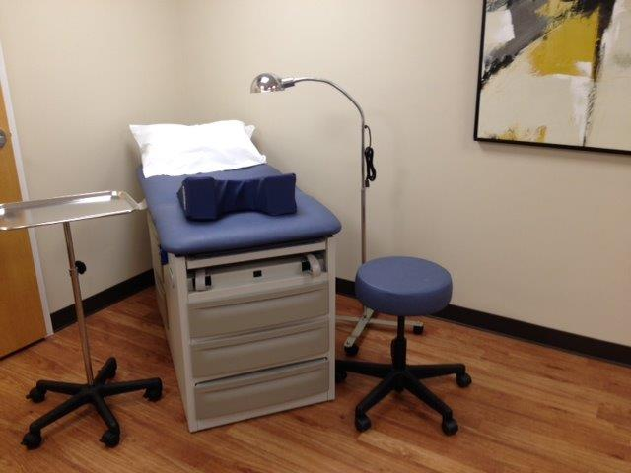
Peer Review
A periodic review process conducted by a collaborative group of practicing SANEs/SAFEs which includes a review of medical record documentation, forms, reports, evidence collection techniques, and photographs in cases of alleged sexual assault.
It provides clinicians the opportunity to share knowledge, provide feedback, and foster skill building in a safe learning environment.
.

Slide 4
Why is it essential to clinical practice?
American Nurses Association (1988)
Office of justice programs
According to the American Nurses Association, “peer review is the process by which professionals from common practice areas systematically assess, monitor, make judgments, and provide feedback to peers by comparing actual practice to established standards.”
The Office for Crime Victims asserts that peer review is not intended to be a punitive activity but instead is a proactive and preventive quality improvement activity which focuses on improvement of patient care.

Slide 5
Benefits of Peer Case Reviews (PCR)
Improves patient care
Increases SANE’s knowledge
Identifies training needs of staff
Increases a more collegial, collaborative SANE team
Increases SANE’s competency in court
Increases SANE Program’s credibility

Slide 6
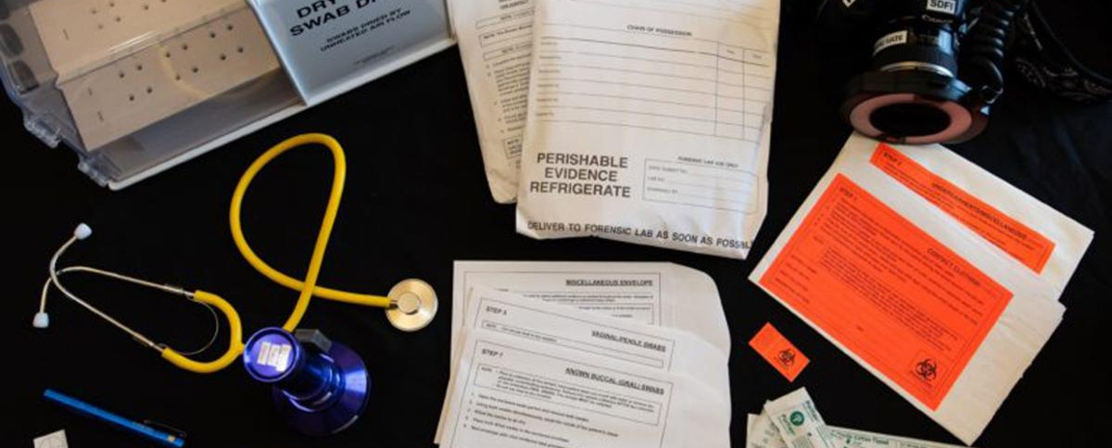
SANEs need a well-defined, and consistent peer review process.
https://cdn.ymaws.com/www.safeta.org/resource/resmgr/imported/SANE%20Peer%20Review.pdf

Slide 7
Best Practice Considerations
Define the purpose of PCR in your SANE Program.
Write a procedure with guidelines establishing the PCR process.
What is the schedule and how often PCR?
Who can attend PCR?
Will any information under review be redacted?
For example, patient, advocate, and examiner’s name.
Other patient demographics
Law enforcement names and badge numbers
Suspect’s name

Slide 8
Best Practices Cont’d
Will a confidentiality statement be required for each reviewer?
How are the practice recommendations agreed upon going to be implemented?
How many cases can be reviewed in the time allotted?
How much time will be allowed to review each case?
How and where are PCR records maintained?
Set aside a minimum of one hour.
Remind all attendees of the confidentiality component of the process.
Start with the positives.
PCR is a safe learning environment.

Slide 9


Slide 10
PCR Form Components
Documentation; Examples -
Signed consent by patient or legal guardian
All handwriting legible
Chart properly signed
Forms completed in its entirety, including N/A and all boxes checked where applicable
Documented who was in the room during the exam
Documented whether or not patient was reporting or non-reporting

Slide 11
Form Components, Cont’d
Medical and Assault History
Evidence Collection and Documentation
1. How was the sexual assault documented?
Ex: Was there enough detail of the SA or not enough to determine where to collect evidence?
2. Was consent obtained for the exam?
3. Were labs ordered if indicated, such as, toxicology screen?
1. Is the chain of custody completed?
2. Does evidence collection correspond to the description of the sexual assault history?
3. Was evidence properly packaged and stored?

Slide 12
Form Components, Cont’d
Photo Reviews
Medications and Referrals
Do the quality of the photographs depict the injury with the proper lighting?
Are the photographs labeled in an orderly and proper manner?
Do the photographs align with the body diagrams and photo log?
Are medication allergies documented?
Were the appropriate medications given?
Were STI and/or pregnancy prophylaxis recommended and documented, if indicated?
Are appropriate referrals and follow-up appointments documented?

Slide 13
Form Components, Cont’d
ADDITIONAL NARRATIVE, COMMENTS, OR RECOMMENDATIONS SECTION
BLANK FORM or
COMMENTS SECTION

Slide 14
Sample SANE PCR Forms

Slide 17
PART I
Age of patient _____________
Examining SANE______________________ __
Date of Exam_________________
Reviewed by___________________________
Review Date _________________
Write: Yes No Not Applicable
Is the exam start time written on medical record?
Are vital signs documented on medical record?
Is STD prophylaxis documented on SANE report?
Is STD prophylaxis documented on medical record? 12.
Is pregnancy prevention documented on SANE report?
Is pregnancy prevention documented on medical record?
Is there a signed consent for the exam from the patient or legal guardian?
Is the time of the assault documented on the SANE report?
Are appropriate medical referrals documented on aftercare instructions?
Is the PERK number written after the MR number on the SANE report?

Slide 18
PART II
Age of patient _____________
Examining SANE________________________________ Date of Exam_________________
Reviewed by____________________________________ Review Date _________________
Write: Yes No Not Applicable
11. If appropriate to the history, was the DFSA documented on the SANE report?
12. Is all handwriting legible?
13. Is the detective name/jurisdiction on demographic forms?
14. Was there a diagram completed of the genitalia?
15. Documentation: gross, TBD, Colposcope?
16. Are genital photos of good quality?
17. Did genital photos adequately show anatomy?
18. Did genital photos adequately show injury?
19. Did the genital photos show abnormal discharge?

Slide 19
Part III
Age of patient _____________
Examining SANE______________________
Date of Exam_________________
Reviewed by________________ Review Date ______________
Write: Yes No Not Applicable
20. Were STD cultures done?
21. Pregnancy test before antibiotics and EOC?
22. Exam position documented?
23. Knee-chest examination for children if positive frog leg.
24. Was the last sexual activity clearly documented?
25. Did the genital injury documentation match the photos?
26. Were there diagram(s) completed of the body/mouth?
27. Were external body injuries photographed?
28. Were the external injuries photographed with and without the ABFO ruler?
29. If bruising or redness present for external injuries, was the color tool used in photographs?

Slide 20
Part IV
Age of patient _____________
Examining SANE_____________________________
Date of Exam_________________
Reviewed by___________________ Review Date ___________
Write: Yes No Not Applicable
30. Did the external injury photos show a 3 step process photography of each injury (far, medium, close-up)?
31. Did the medical case review validate the SANE’s findings?
32. I agree with the examining SANE’s findings.
33. Was the report/paperwork completed immediately post exam?
Comments:
__________________________________________________________________________________________________________________________________________________________________________________________________________________________________________________________________

Slide 21

PUTTING IT ALTOGETHER
Peer Case Review increases knowledge
Every exam can be an opportunity for learning
PCR increases autonomy in clinical practice
PCR increases the quality of care
Decreases burnout
Increases credibility in court
Increases a more open, collaborative team

Slide 22
PCR’S GOAL:
Quality Comprehensive Patient-Centered Care
Sample Case Scenario:
A 25 year-old woman arrives at the local hospital’s emergency room at 2:00am reporting that she was sexually assaulted 7 hours ago outside her job in the parking lot. She worked overtime and was the only one left in the building when it was time for her to leave. As she approached her car, a man attacked her from behind and forced her into the car. She stated he committed oral and vaginal assault on her. She did not report it to the police, instead drove home alone, and telephoned a cousin who convinced her to go to the Emergency Department for treatment.

Slide 23
PEER REVIEW RESOURCES
https://www.safeta.org/page/PeerReview1
https://www.mosaicgeorgia.org/pro-sane/
https://www.nsvrc.org/blogs/sane-program-peer-review
https://www.ovcttac.gov/saneguide/maintaining-a-quality-program/peer-review/

Slide 24
REFERENCES
Greeson, Megan R.; Campbell, Rebecca and Kobes, Shannon K.E. A Step-by-Step Practitioner Toolkit for Evaluating the Work of Sexual Assault Nurse Examiner (SANE) Programs in the Criminal Justice System, 2008. file:///S:/@%20SANE/_SANE%20Protocols/Reimbursement/Evaluating%20SANE%20programs%20.pdf
https://www.ovcttac.gov/saneguide/management-of-sane-programs/sexual-assault-nurse-examiners/
https://www.fcasv.org/sites/default/files/SANE%20Peer%20Review%20Guidance%20Document%20submitted%2012.18.17.docx.pdf
IAFN SAFE-TA Webinar: SANE Peer Review Iperen, Jessica V. and Pittenger, J. What do Sexual Assault Cases Look Like in Our Community? A SART Coordinator’s Guidebook for Case File Review, 2014.
Linden, J. 2011. Care of the Adult Patient after Sexual Assault. N Engl Med 365:9, p. 834-841.
Office for Victims of Crime, SANE Program Development and Operation Guide, 2016. HTTPS://WWW.OVCTTAC.GOV/SANEGUIDE/MAINTAINING-A-QUALITY-PROGRAM/PEER-REVIEW/ Sexual Assault Forensic Examination Technical Assistance, (SAFEta), PEER REVIEW FORMS

